Slide 1
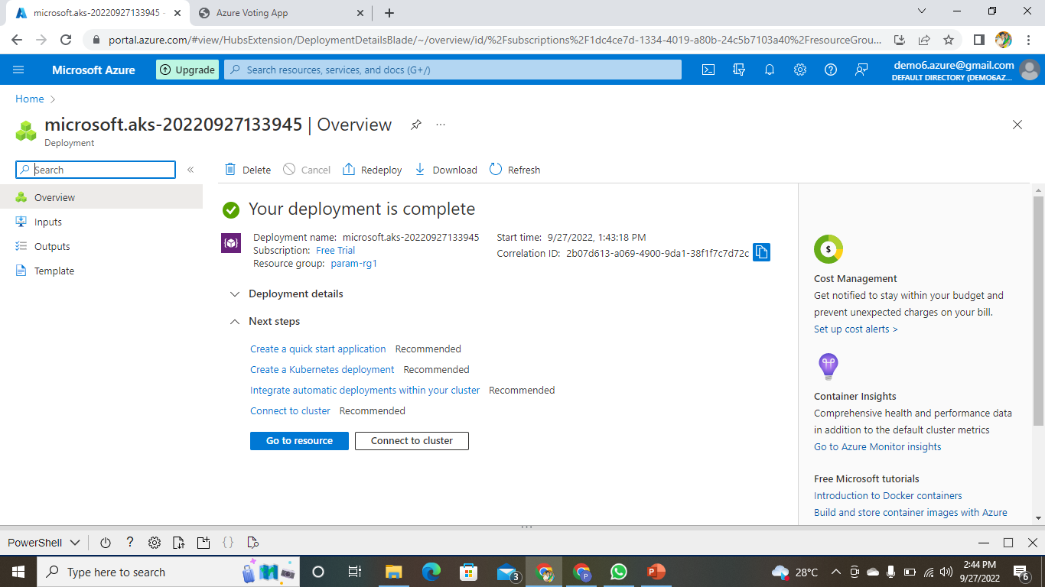
AKS CREATION
CREATING AKS CLUSTER:-

Slide 2
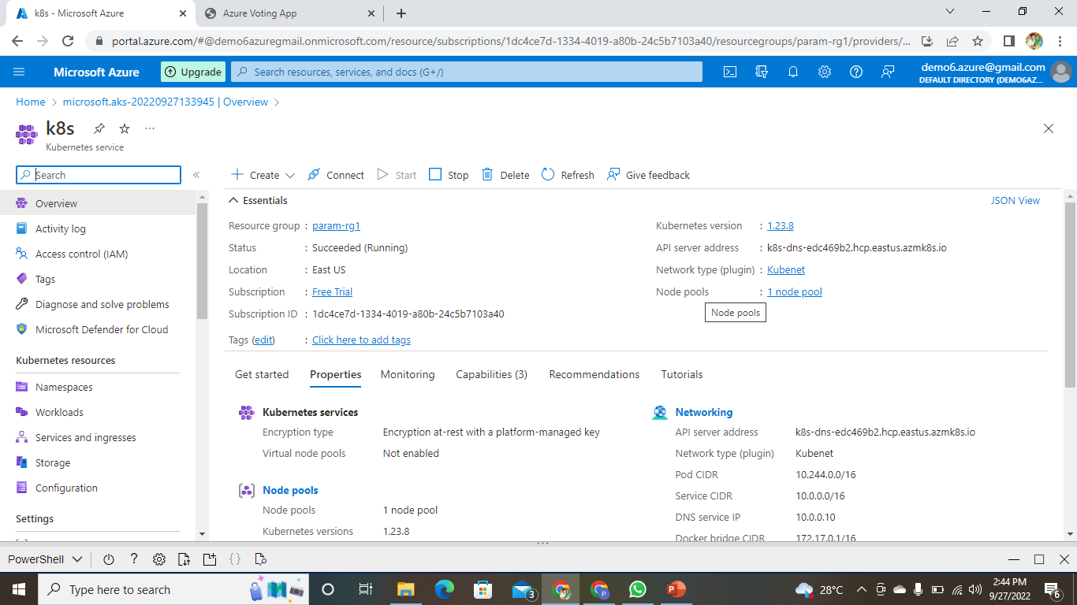
AKS CLUSTER CREATED

Slide 3
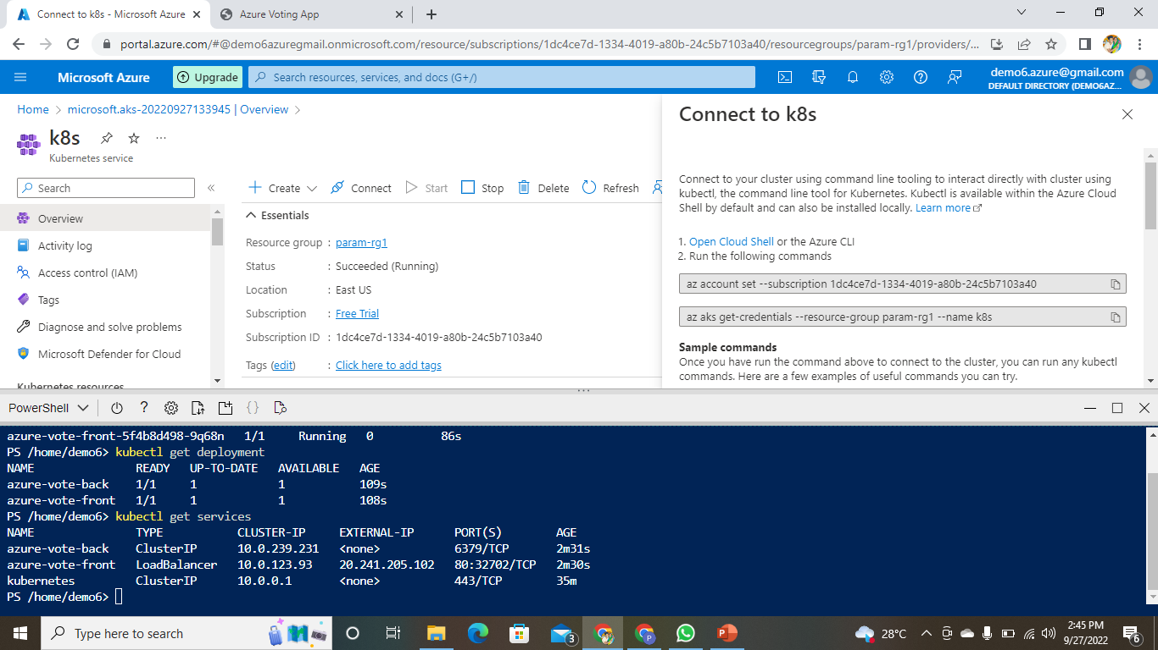
CONNECTING AKS CLUSTER TO P.T

Slide 4
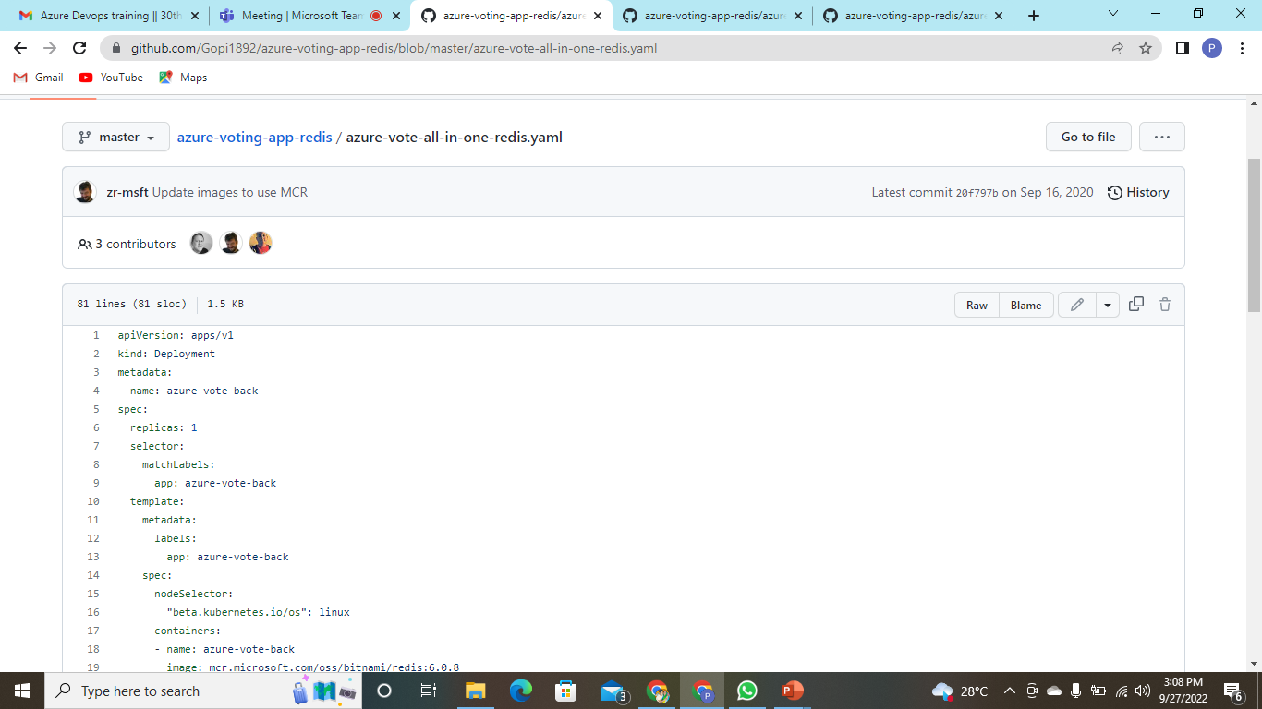
COPY THE YAML FILE

Slide 5
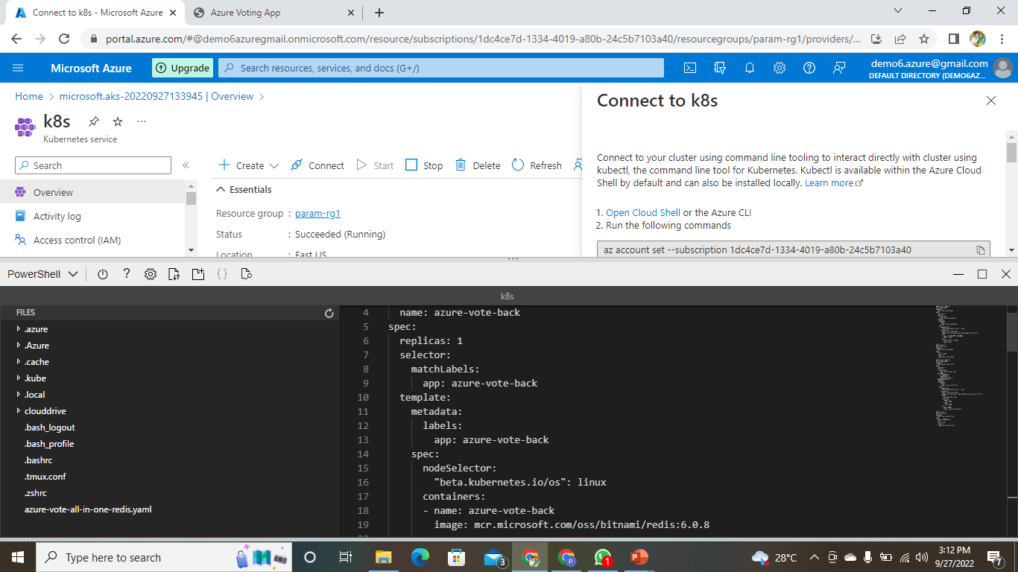
PASTE THE FILE IN THE EDITOR AND SAVE IT

Slide 6
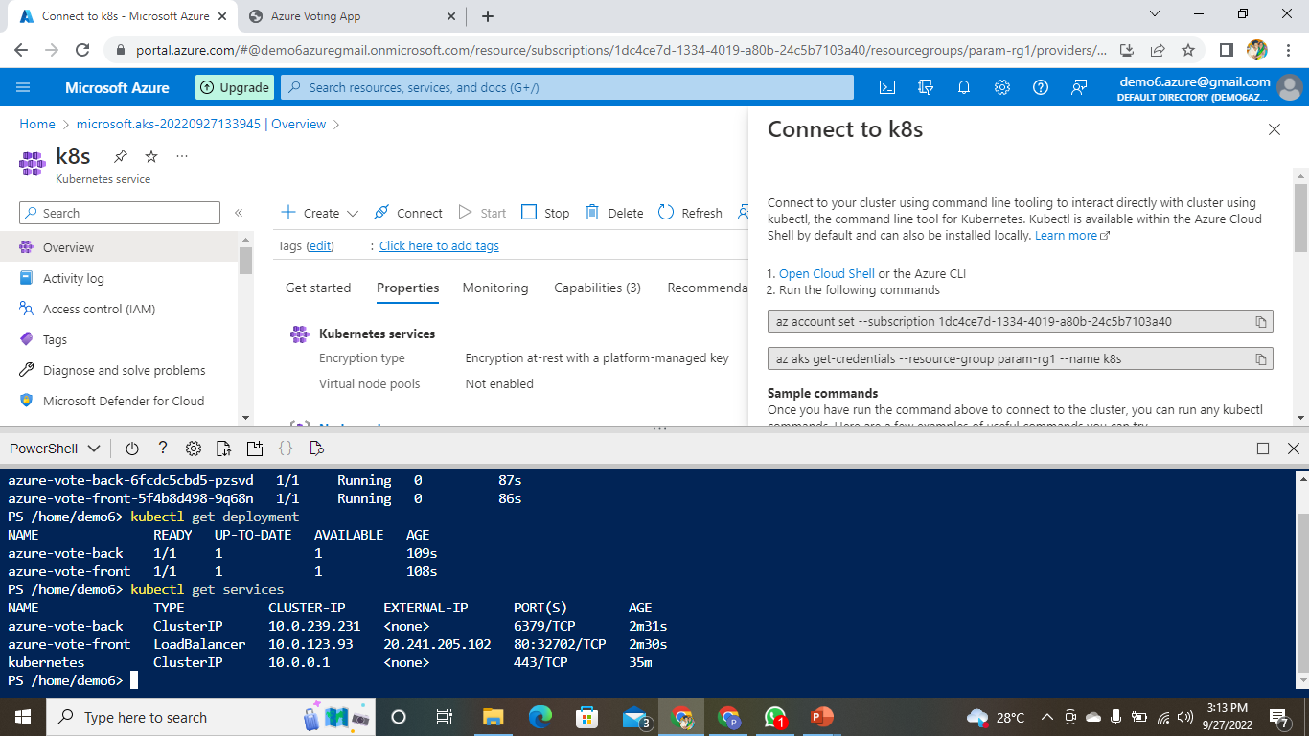
RUN THE COMMAND TO RUN THE YAML FILE

Slide 7
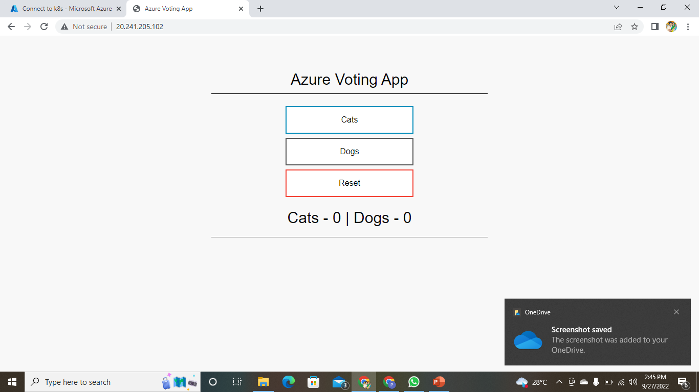
COPY THE EXTERNAL IP ADDRESS AND PASTE IT IN THE BROWSER TO GET THE OUTPUT

Slide 8
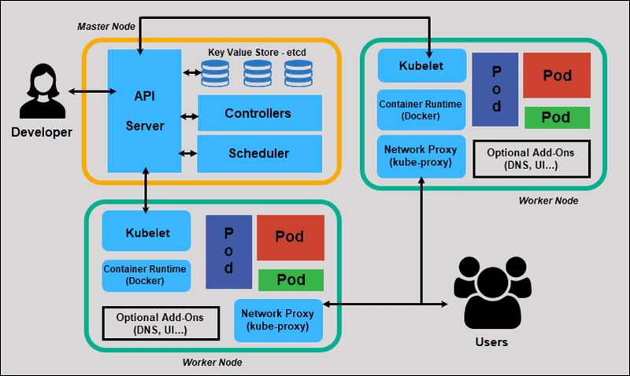
ARCHITECTURE OF KUBERNETS

Slide 9
K8S
Master node
Worked node
A Kubernetes cluster is made up of one master node and several worker nodes.
The worker nodes are responsible for running the container and doing any work assigned to them by the master nodes . The master node looks after scheduling and scaling applications

Slide 10
Kube -apiserver
The api server is a component of the kubernets

